Slide 1
Welcome!
Please pick up your English binder.
Pick up an index card.
Open to: Tracking My Growth in Narrative Writing. Read W73b.
Talk with your group and come up with 3 reasons why the narrative techniques listed in W73b can help make a story more interesting. Everyone in your group should write down these 3 reasons on the index card. You have 3 minutes and 33 seconds to complete this warm up.

Slide 2
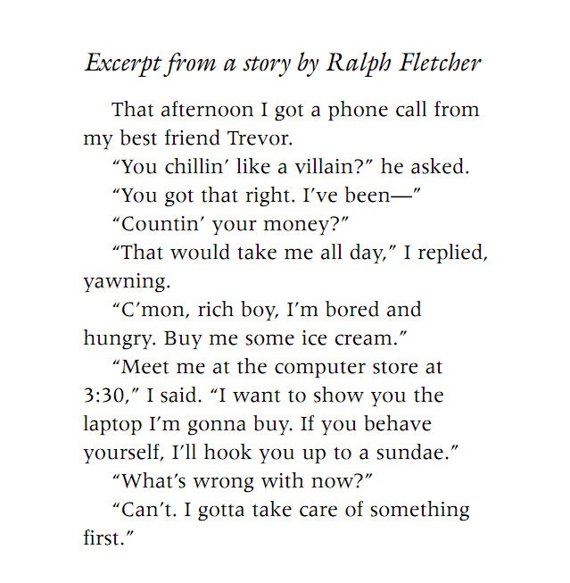
Mentor Text
Notes:
Ask students what they notice about the dialogue. Create a rules list.

Slide 3
Peer Text
…as I dropped it, the match burned my thumb. I was crying very loudly, and my cousins rushed to me . They were asking me questions about what happened…
*Don’t tell the reader that someone asked questions. Have the speaker ASK the questions.

Slide 4
Peer Text
…as I dropped it, the match burned my thumb. “Aaahhhh!” I cried very loudly.
My cousins rushed to me . “What happened?” they all asked at once.
“I burned my thumb!”

Slide 5
Peer Text – Let’s Fix It
“I’ll race you, you know, to the top” dared Brady, he’s almost a year older than me, but I have more time going up the hill. “sure why not? A little practice won’t hurt.” I replied. When we reached the top he wanted to play tag(probably because he lost). ”Are you kidding me?!” said CJ.
Notes:
New speaker/new paragraph

Slide 6
Fixed!
“I’ll race you, you know, to the top!” dared Brady. He’s almost a year older than me, but I have more time going up the hill.
“Sure. Why not? A little practice won’t hurt,” I replied.
When we reached the top he wanted to play tag (probably because he lost). ”Are you kidding me?!” shouted CJ.
Notes:
New speaker/new paragraph

Slide 7
7H English Music Policy
In order to listen to music during work time, you must meet this criteria:
Have a C or higher
Have no more than 2 missing formative assessments
You must choose a station (Pandora, etc.) or select music from your phone. Then, you should not look at the music source again. If music causes you to have less work time – you will have no more music.
You must be able to hear me talk at a normal level at ALL times.

Slide 8
Your Turn
Return to your personal narrative. Today we work on dialogue.
Log on
Join Net Support
Go to your story
Add dialogue or review dialogue for rules.
Need Help? Go to the Weebly!
If you finish early, see the Weebly for more revising strategies.

Slide 9
Exit
On an index card, explain what we learn about your plot or your character from the dialogue you have in your story. In other words, what is the dialogue doing in your story? Turn in card to box.
Log off your computer. 9th hour – put the computers away.
Put your binders away neatly.
Planner
CW - dialogue
HW – final draft of narrative due Friday

