Slide 1
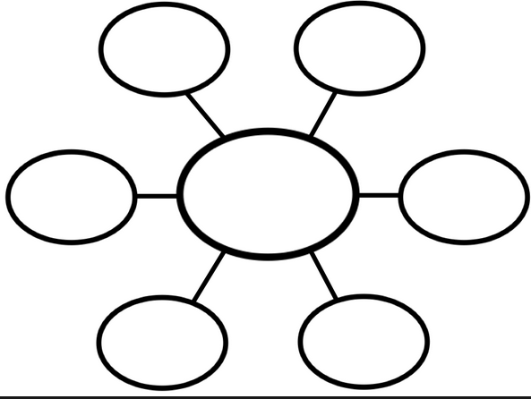
Welcome! - Pick up your English binder.
Take out a lined sheet of paper.
Write your heading.
Write the title: Who I Am
Create a web.
In the middle, write
“Me.”
Brainstorm all the labels
and titles that tell who you are.

Slide 2
Parts of the Next Project
My Place in the Community
You
Your family
Your community
Your school
Your state
Your region
Your country

Slide 3
Backward Mapping
Final project – individual
Essay
Oral Presentation with PowerPoint or Prezi
Group Work
Small groups to synthesize Who We Are information
Assignments
Origin of Name
Today’s Web

Slide 4
Reminder & Exit
Turn in Appositives (Pattern 6)
Turn in Name
Put away English binder.
Planner
CW: web; project introduction
HW: make up work

